Slide 1
Update of Requests for Disaster Declarations and Recent Rain Events
April 16, 2015

Slide 2
Anderson Barren Bath Boyle Boyd Breathitt Butler Caldwell Carlisle Clark Clay Crittenden Cumberland Edmonson Elliott Estill Fayette Floyd Franklin Gallatin Green Harrison Harlan Hart Jackson Jessamine Knott Knox LaRue Lawrence Lee Leslie Letcher Lewis Lincoln Lyon Madison Magoffin Marshall Mason McCracken Menifee Metcalfe Monroe Montgomery Morgan Nicholas Owen Owsley Pendleton Perry Pike Powell Robertson Rockcastle Russell Simpson Spencer Taylor Trigg Union Washington Woodford Wolfe
February 15-22, 2015 Severe Winter Storm Declaration Request Submitted by April 16, 2015 for 64 Counties
Total Value of Joint Preliminary Damage Assessments: $7.8 million

Slide 3
March 2015 Severe Winter Storm Declaration Request Must be Submitted by April 29, 2015
Total Value of Joint Preliminary Damage Assessments: $19 million
Anderson
Bath
Bell
Bourbon
Boyd
Breathitt
Butler
Calloway
Carlisle
Carter
Casey
Clark
Clay
Crittenden
Elliott
Estill
Fleming
Floyd
Franklin
Fulton
Grant
Greenup
Hancock
Harrison
Hart
Johnson
Knott
LaRue
Lawrence
Lee
Leslie
Letcher
Lewis
Madison
Martin
Mason
Menifee
Metcalfe
Montgomery
Morgan
Nicholas
Owen
Owsley
Pendleton
Perry
Pike
Robertson
Rockcastle
Rowan
Spencer
Trigg
Webster
Woodford
Wolfe

Slide 4
Severe Storms Beginning April 2, 2015 Governor Issued State of Emergency on April 3, 2015 If your county had damages to public infrastructure, private residences, or business: - Declare a Local State of Emergency - Complete Damage Assessments for all damaged properties - Photograph damage sights - BEFORE - repairs begin - Maintain detailed records regarding - Volunteer Efforts - Deaths and Injuries - Sheltering/Feeding Activities - Detours (length, duration, # of impacted citizens

Slide 5
For damages to roads, bridges, buildings, equipment, parks, utilities, etc.: - Report damages for county and all eligible applicants in county on the KYEM 501 Damage Assessment Form - Show all damage to infrastructure by: amounts category location - Submit forms to KYEM Area Office

Slide 6
Damage Assessment Forms: Public Assistance Form 501 - Provide name for person conducting damage survey - Each site must be listed separately - Provide description of damage - Combine all damages in county on one submission (cities, schools, hospitals, etc.) - Make cost estimates as close as possible - Identify all damages - don't stop when threshold is met

Slide 7
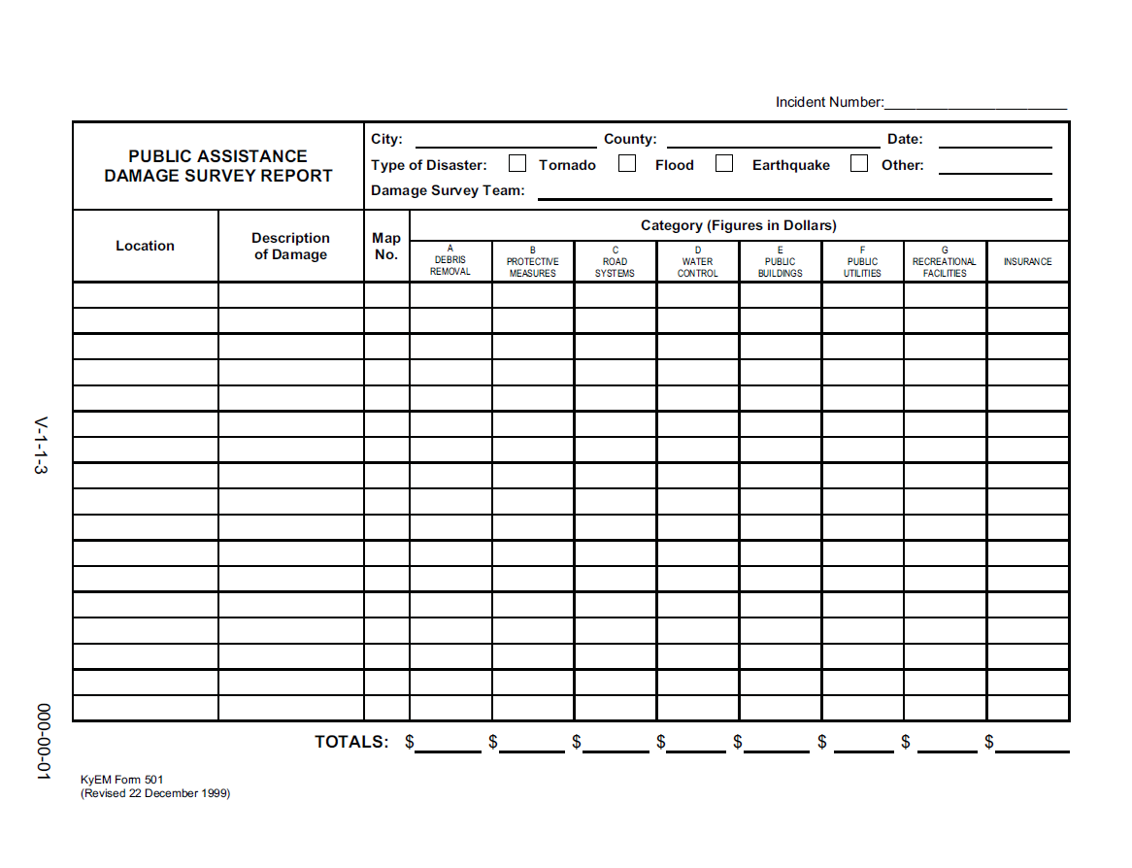
KYEM Form 501

Slide 8
FEMA will not cover damage expenditures related to debris in waterways.

Slide 9
If you have waterway issues which involve: - Debris or bank erosion that is causing damage or threatening to damage to improved properties such as homes, bridges, businesses CALL NATURAL RESOURCES CONSERVATION SERVICE (NRCS) http://www.nrcs.usda.gov/wps/portal/nrcs/main/ky/contact/ Kentucky NRCS State Office 771 Corporate Drive Suite 210 Lexington, KY 40503 Phone 859-224-7350

Slide 10
Damages to Roads and Bridges:
For bridges over 20' to be eligible for FEMA funding: You must have proof that the bridge has received regular inspections by KY Transportation Cabinet.
Ensure you have maintenance records to prove pre-disaster condition of roadways.

Slide 11
Landslides - Temporary Measures:
Cost-effective measures are eligible if poses an immediate threat to life, public health and safety or improved public or private properties
- Temporary Draining
- Partial excavation at the head to reduce driving force
- Backfilling or buttressing the toe
- Installing barriers to redirect debris flow
- Temporary relocation of a facility (i.e. road) if cost effective
- Site grading

Slide 12
Landslides - Permanent Work:
Repairs a facility (i.e. road) damaged by the slide
- May need to prove that site was stable before event
- Geotechnical studies may be required
- If disaster was the only cause of the slide, FEMA will assist with slope stabilization

Slide 13
406 Mitigation Opportunities:
Examine every damaged facility site for mitigation opportunities:
- Increased culvert sizes
- Ditching
404 Mitigation Opportunities
What can be done to lessen the impact on citizens from future disaster events?
- Buyout of homes which have had repetitive flooding

Slide 14
Damage Assessment Forms: Individual Assistance Form 551 - Provide name for person conducting damage survey - Each residence must be listed separately - Every section must be completed for each residence - Water Depth is not yes or no: list how much water was in each level. Indicate if your are reporting inches or feet - If families are not there when you examine the sites, then you need to estimate income and insurance coverage

Slide 15
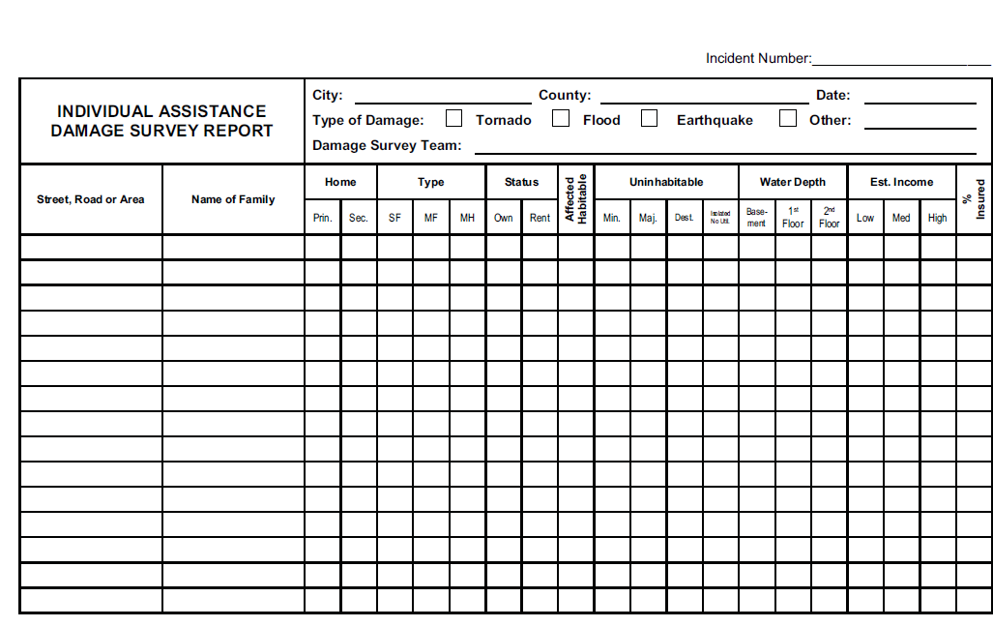

Slide 16
To Date: April Storm Joint Damage Assessments Have Been Conducted or Scheduled for: PA, *: PA and IA **: IA Only Bath * Bourbon * Carter ** Breathitt * Bullitt Rowan ** Elliott * Estill Scott ** Franklin * Jefferson * Spencer ** Johnson Lawrence * Lee Lewis Madison * Magoffin Morgan Owsley Wolfe

Slide 17
April Storm Joint Damage Assessments The following counties have Transportation Cabinet reported amounts which are above or nearly meet the county's threshold. Need PA Damage Assessments (Form 551) for: Clark Menifee Oldham Pike Powell Rowan

Slide 18
Joint Damage Assessments Be Prepared - Identify a meeting location for the team - Have transportation available - Have your records ready for review - Provide photos, maps, news articles

Slide 19
Be Prepared - map all damage sites - list all damage sites and types of damages - timesheets, salary and benefit rates - equipment logs - material logs, costs - contracts, invoices, bills - insurance policies - volunteer efforts - pre-identify any environmental concerns

Slide 20
Have the right people on your assessment team - Road Foreman - Treasurer, Payroll Clerk - Representatives from other reporting entities such as cities, water districts, etc. Review all records and include any and all expenses not previously reported Show FEMA everything - visit all damage sites

